Slide 1

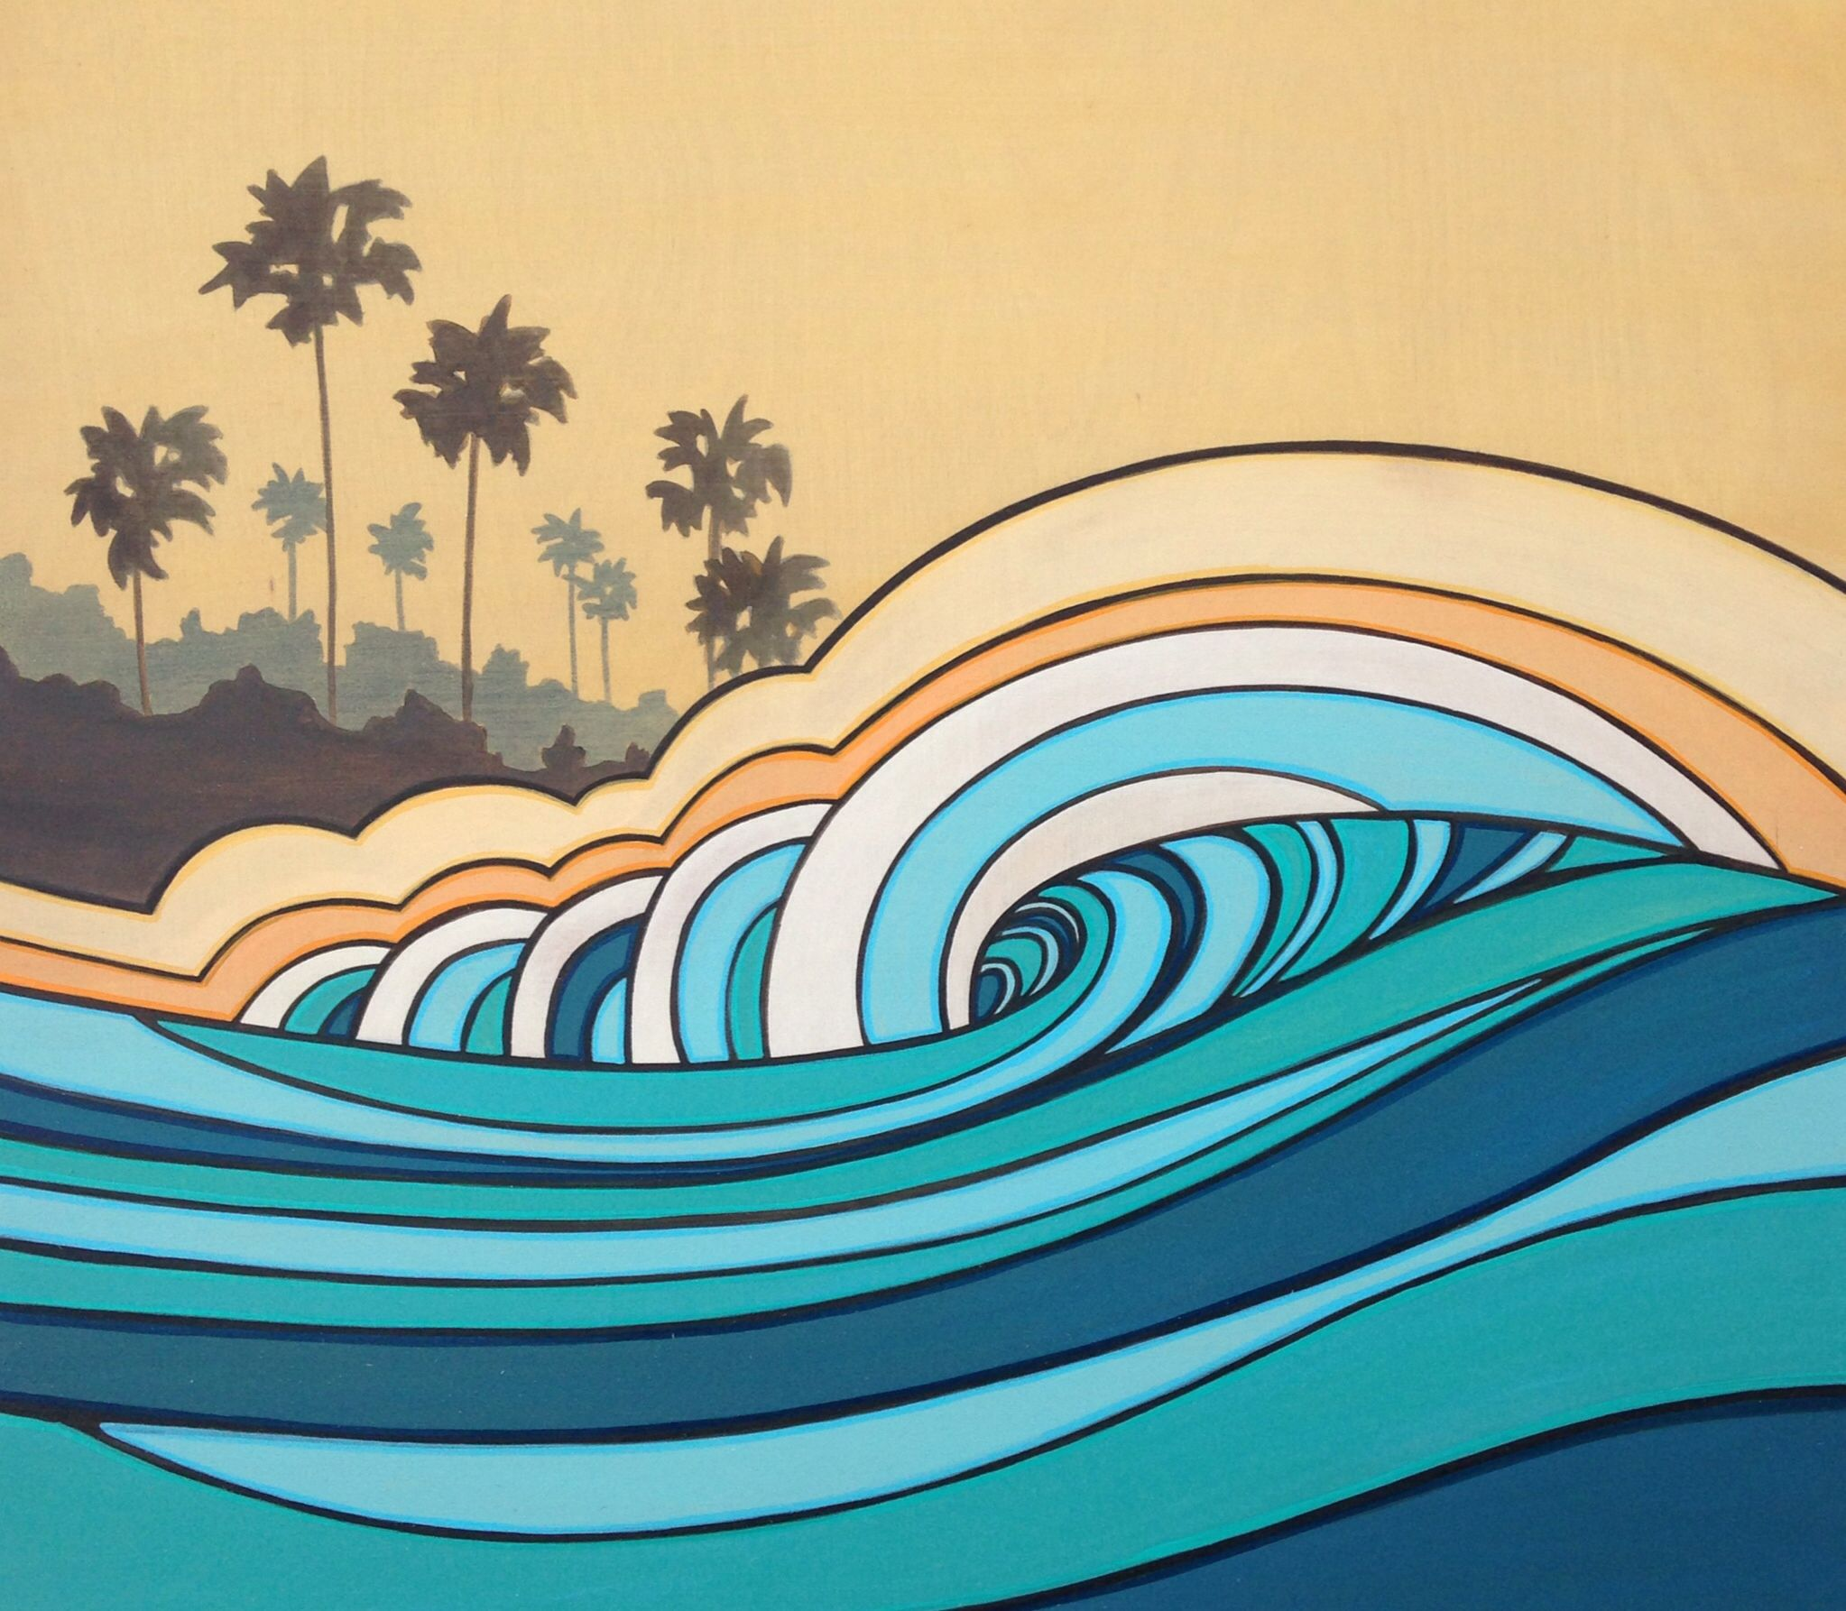
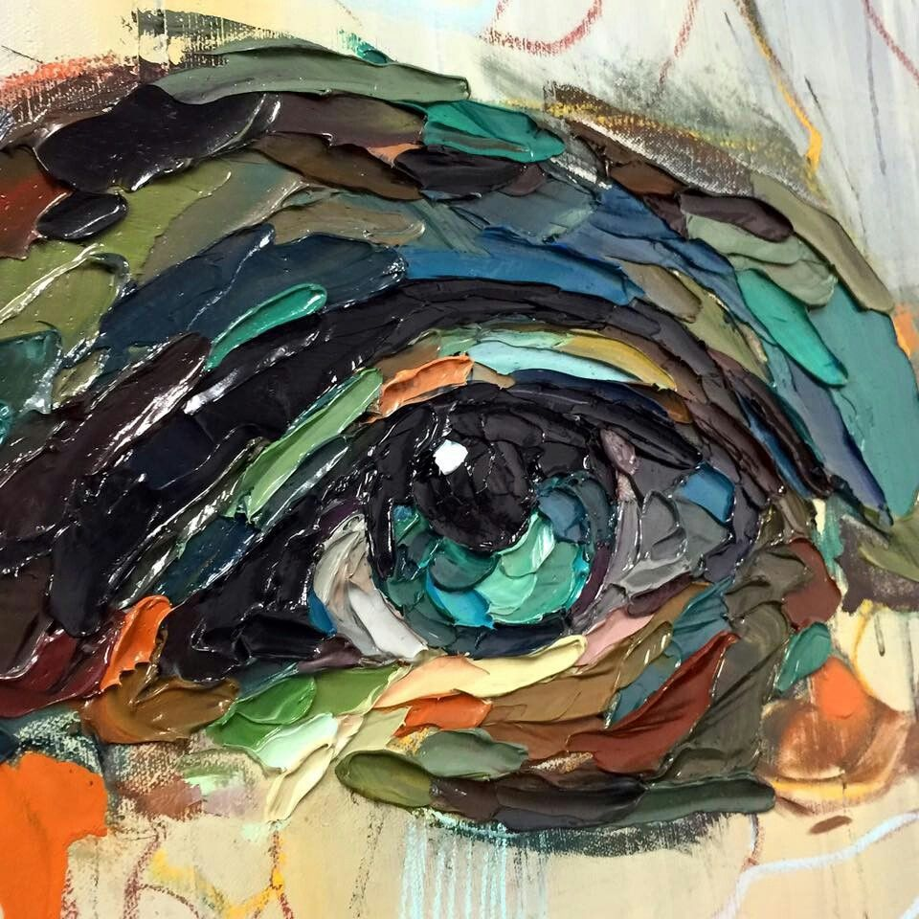


Strings
A Digital Art Gallery

Slide 2
Contains
General Idea
Tools
Conclusion
Data-flow Diagram
Database Structure

Slide 3
General Idea
This is an Art Gallery application to be hosted on web, named as Strings.
It will connect the artists & art community to potential followers.
It will have features such as Like, Follow, Save, Share, as well as Upload & Delete

Slide 4
Tools I’ll be using
HTML
CSS
JS
NodeJS
PostgreSQL
Front-End
Back-End &
Database

Slide 5
Database
Strings
Digital Art Gallery
Guest User
Like, Share, Save, etc.
User Registration & Log In
Upload & Delete Own Post
Data-Flow Diagram

Slide 6
USER
CONTENT
ACTIONS
USER_ID
USER_ID
USER_ID
USER_NAME
CONTENT_ID
CONTENT_ID
USER_EMAIL
TITLE
LIKE
REG_DATE
DATE
SAVE
LEVEL
IMAGE_URL
Database Structure

Slide 7
Conclusion
So this will be my project for BCCA final year.
Mr. Doshant Mahesh Giradkar
G.S. College of Commerce, Wardha

